Slide 1




Next Top Interpolation Method
Comparing spatial interpolation methods for use by U.S. Department of Energy- Office of Legacy Management PRESENTED BY: ALYSSA RENTERIA
Mentors: Angelita DENNY & Josh linard
Arizona space grant consortium
TuCSon, az

Slide 2
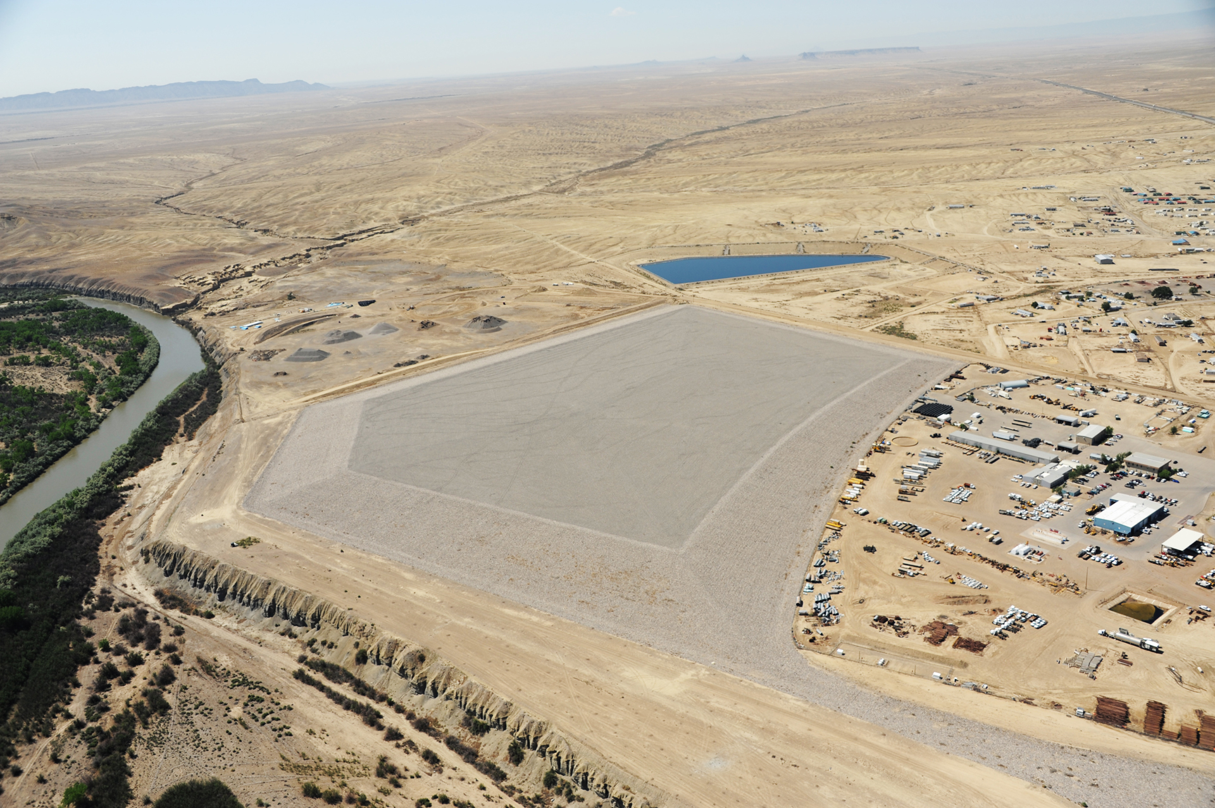
OUTLINE
Introduction
Relevance
Hypothesis
Example of Experiment
Analysis Methods
Results
Acknowledgments

Slide 3
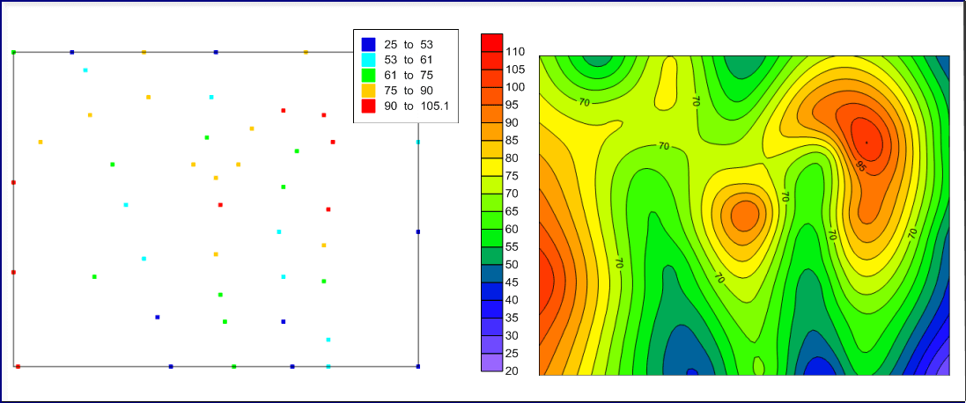
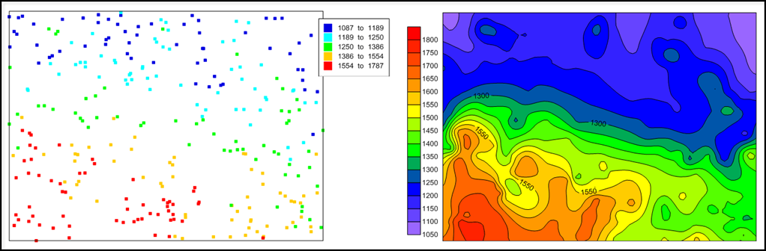
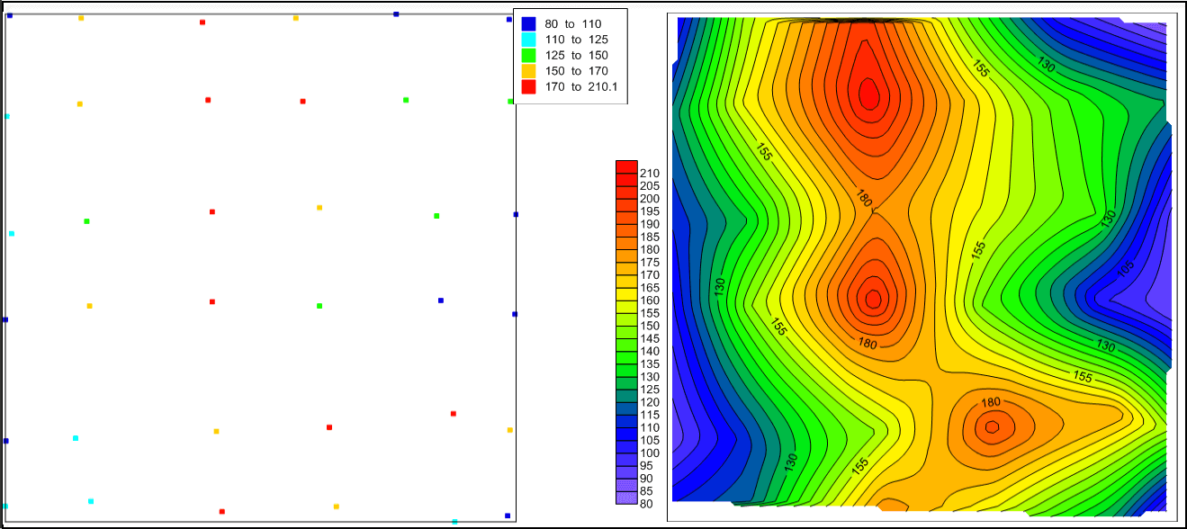
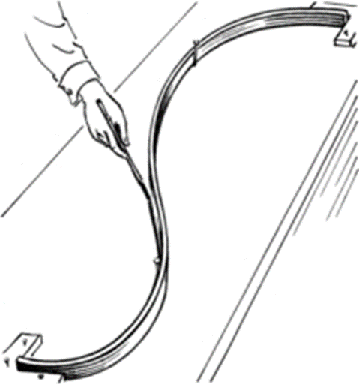
iNTRODuction
Geostatistical | Deterministic
Kriging | IDW
 | Natural Neighbor
 | Spline

Slide 4
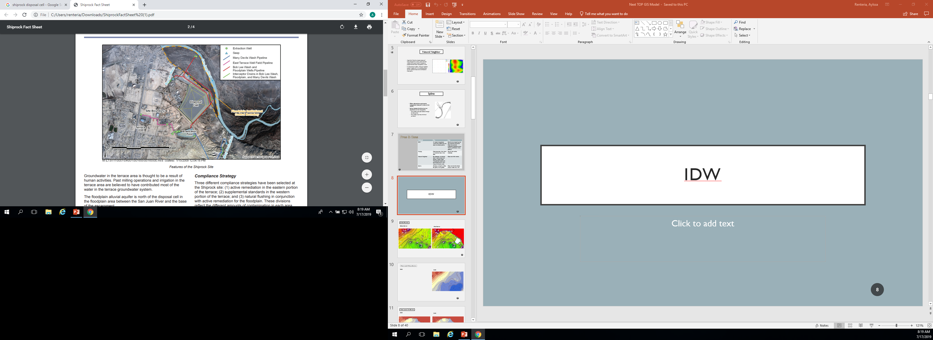
Why is this Important?
A tool to predict environmental conditions
Easily reproducible for transparency between the private and public sector

Slide 5
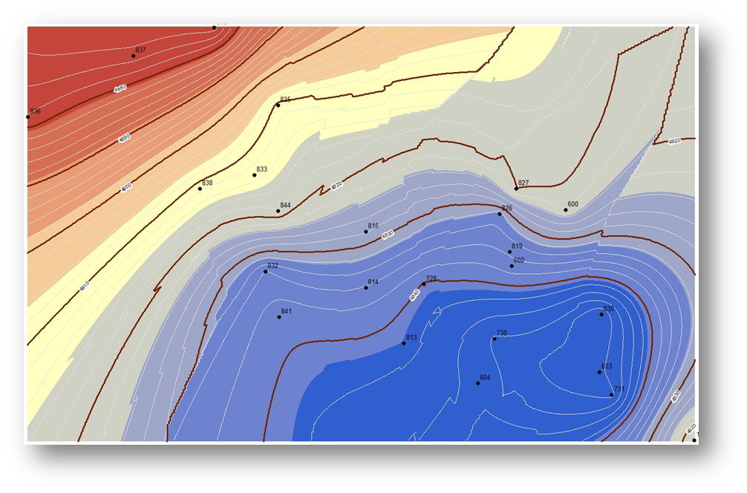
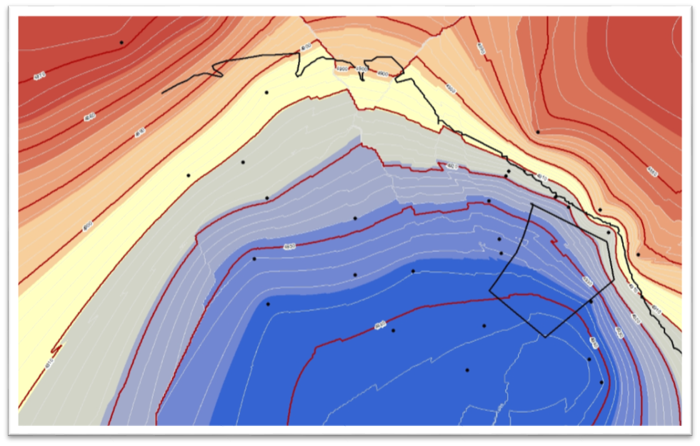
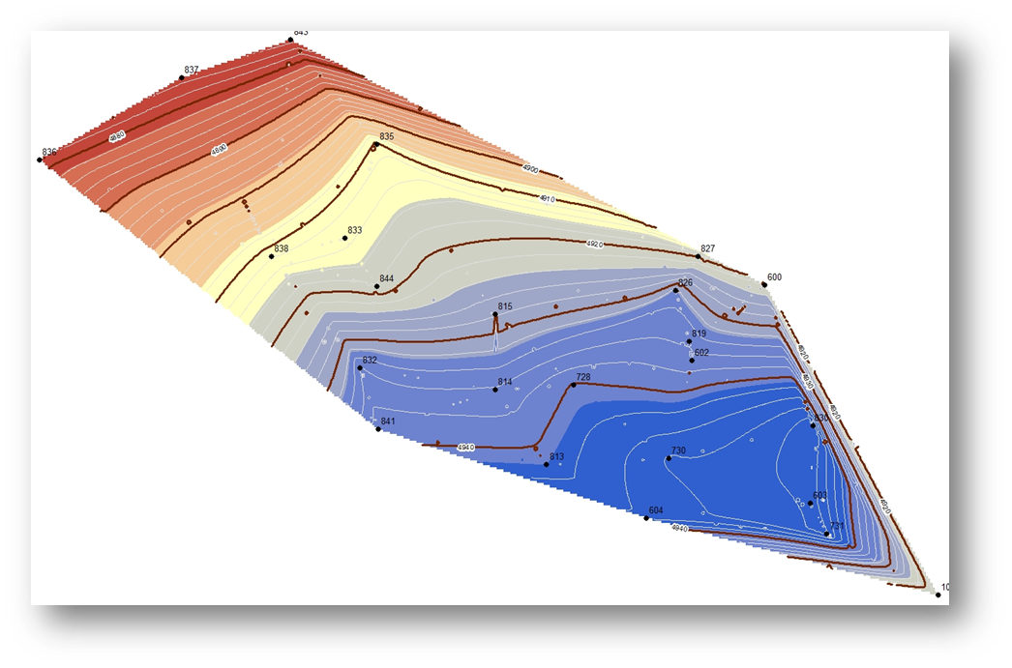
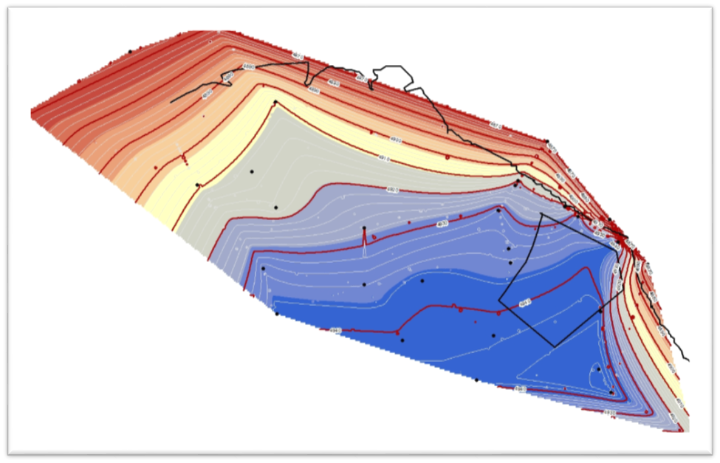
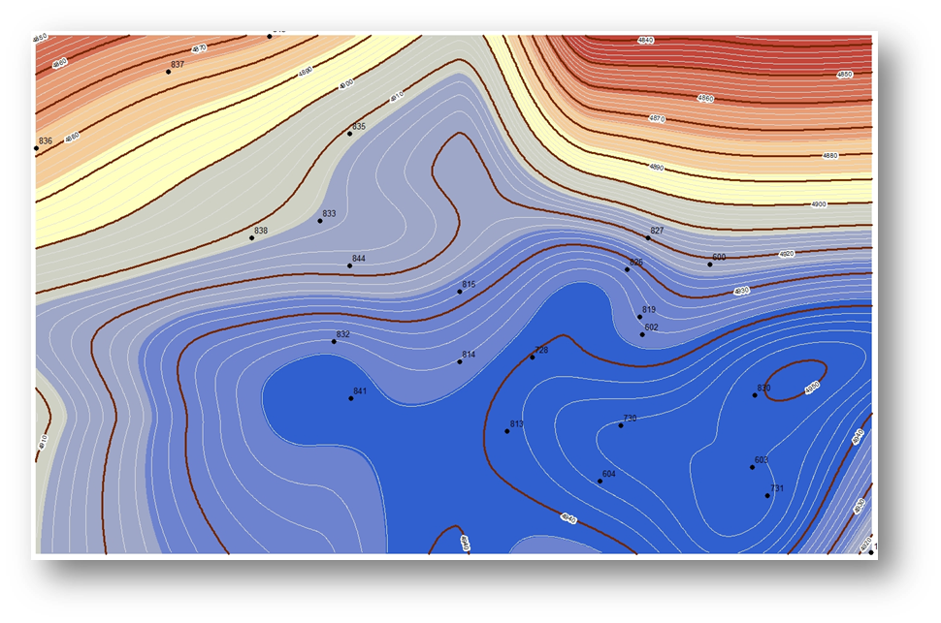
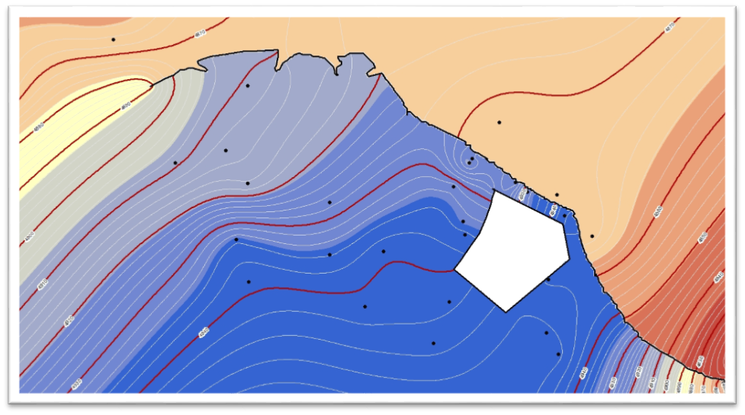
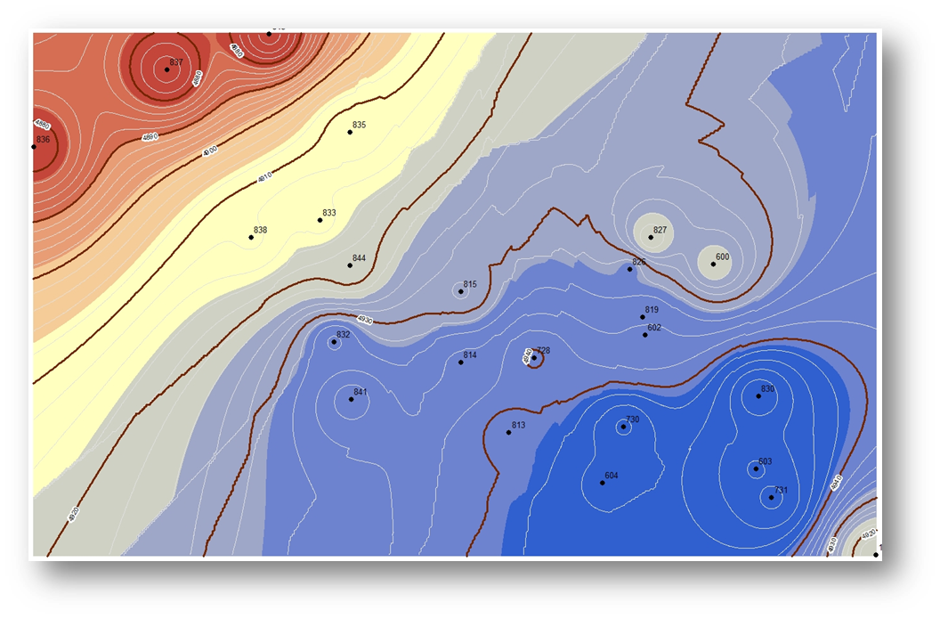
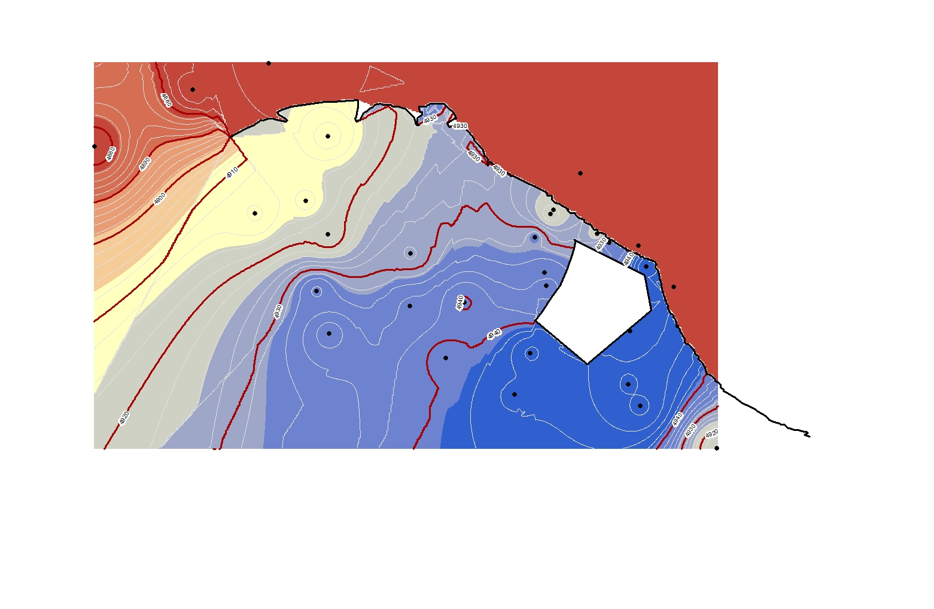
Sample of spatial interpolation comparison
2018 Water Levels at Shiprock, NM
Kriging
Natural Neighbor
Before
After
Before
After
Spline
IDW
Before
After
Before
After

Slide 6
Accuracy Assessment methods
Previous Map Reference

Slide 7
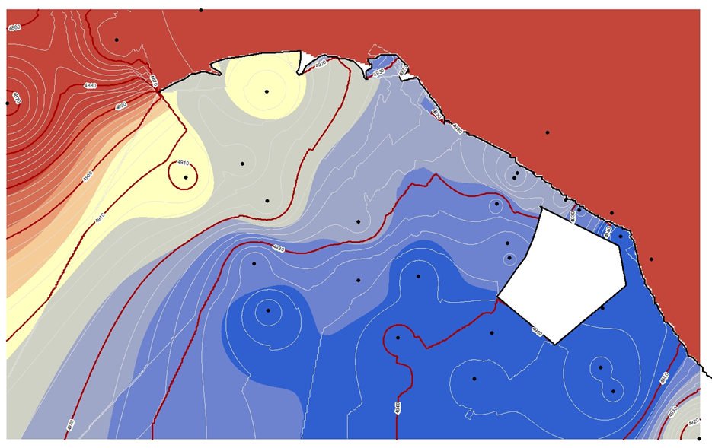
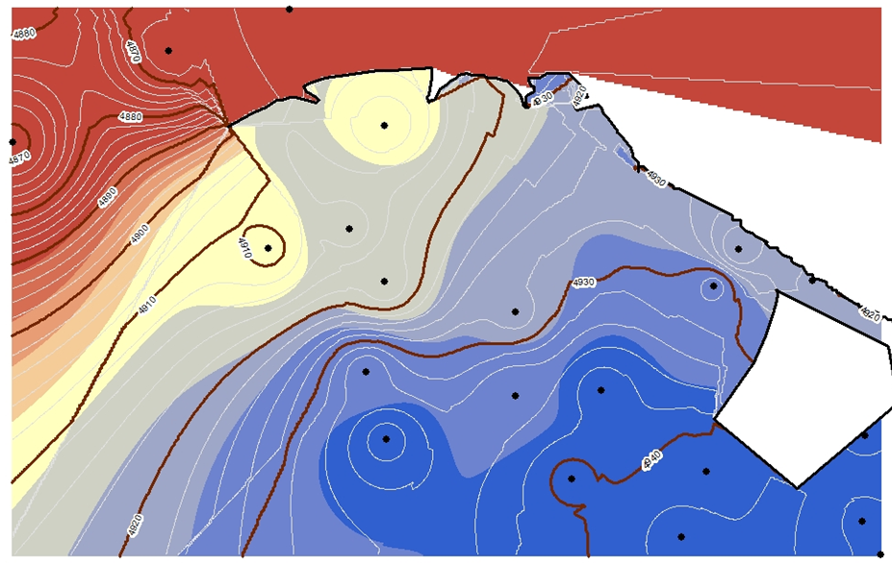
Accuracy Assessment Methods
Leave One Out Comparison
IDW
Before
After

Slide 8




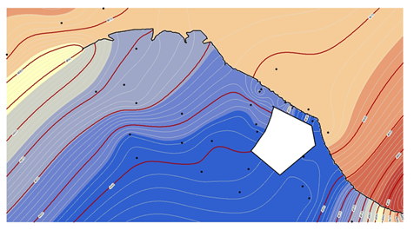
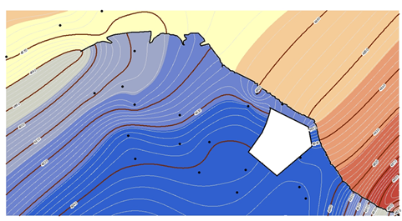

Spline

Slide 9
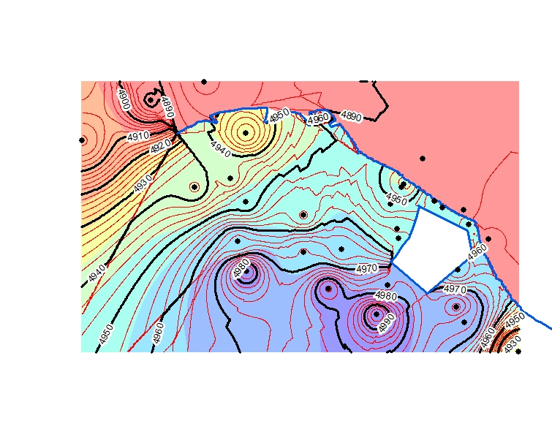
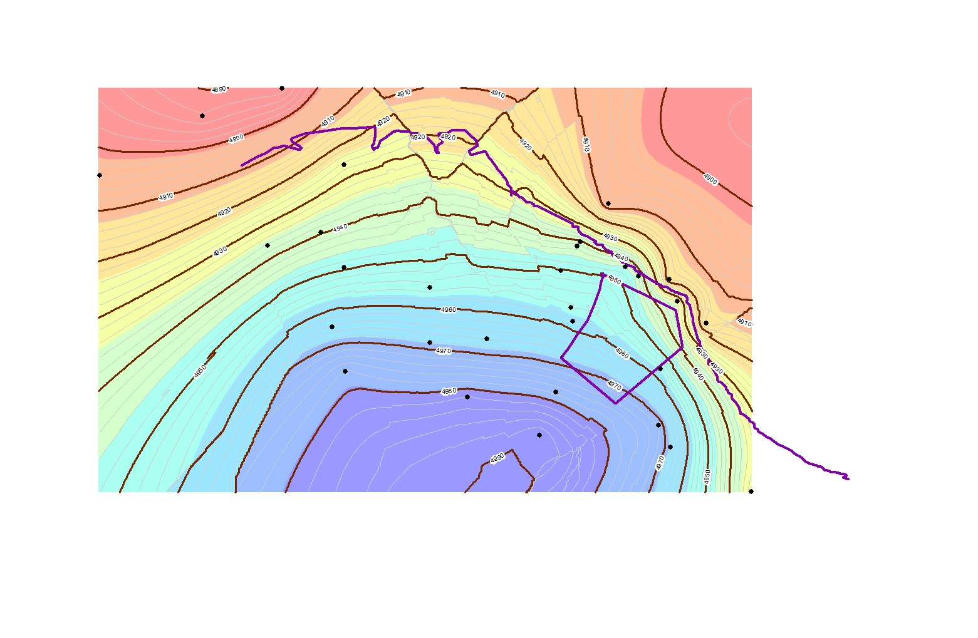
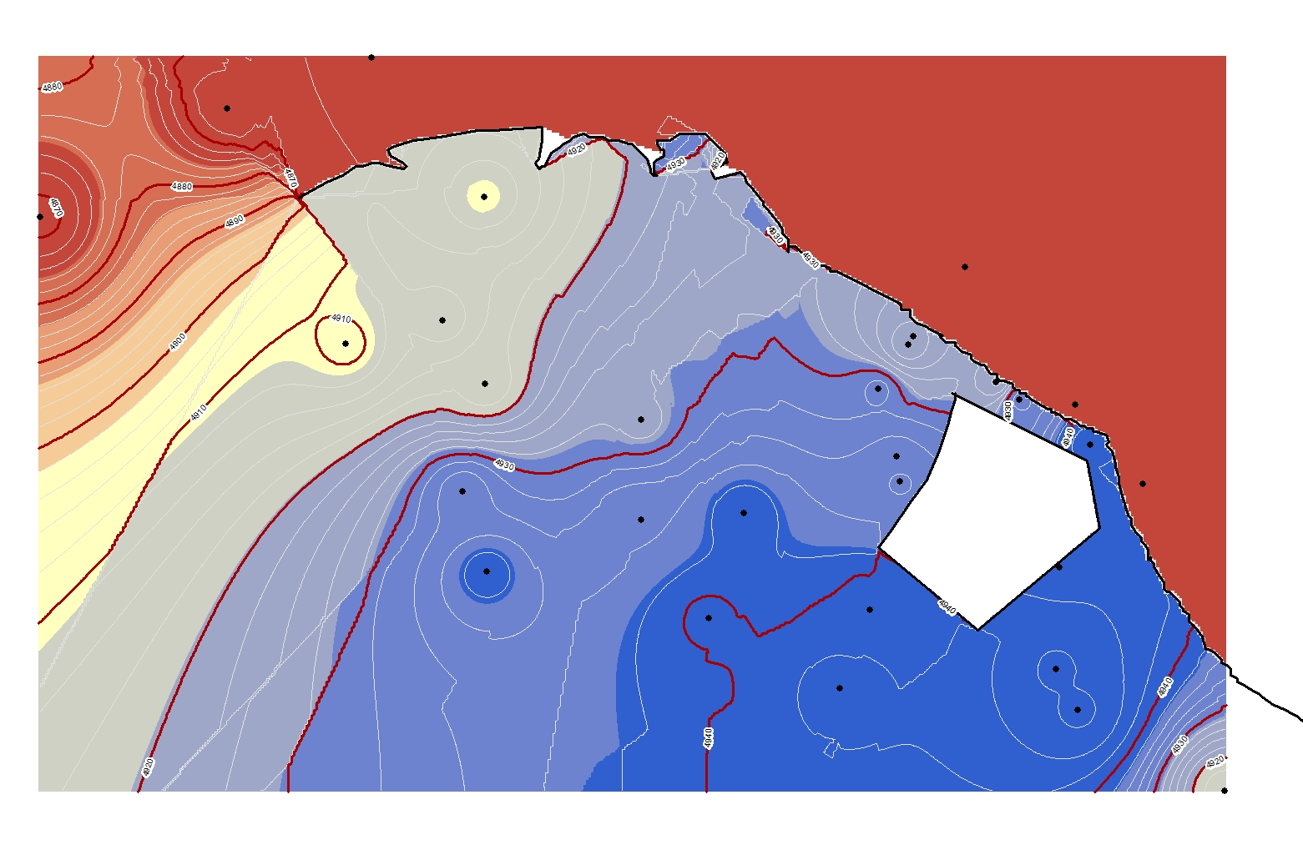
RESULTS
FUTURE ADJUSTMENTS
IDW is the winner of the experiment for handling various accuracy assessments and showing a good representation of the area at Shiprock.
Try another process for creating a barrier in the kriging method.

Slide 10

Was this project helpful?
Help uncover some of the issues of a standard universal method
Increased understanding in how GIS can be manipulated, to provide better understanding of an area
Create maps that are proven accurate through modern algorithms and past methods

Slide 11
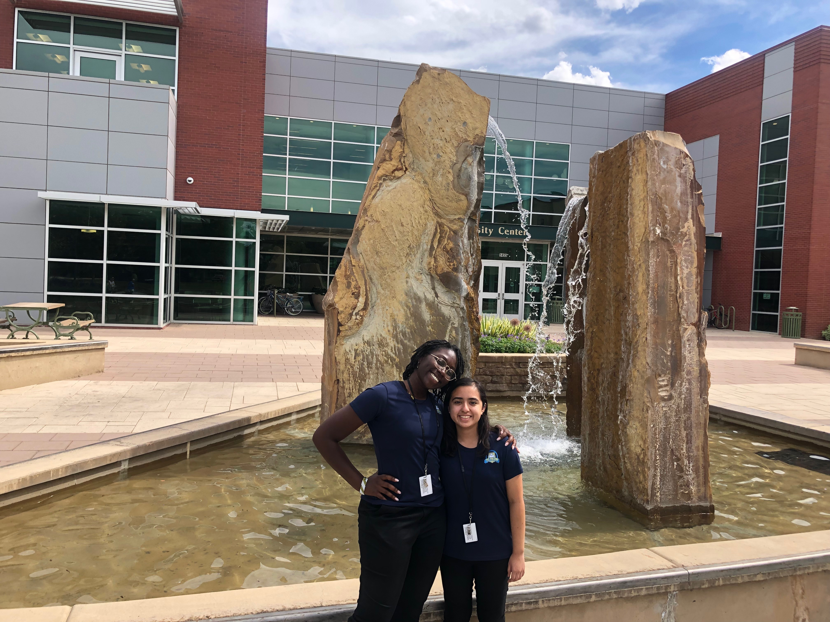
Acknowledgments
I would like to express my deep gratitude to my mentors Josh Linard and Angelita Denny; the subcommittee for their guidance, encouragement and useful critiques of this project. My grateful thanks are also extended to Mr. Dander for his support with the Shiprock data. I would also like to thank Mr. Brown from Pre-College University, for giving me the opportunity to participate in the Mentorship for Environmental Scholars program. I would also like to thank Michelle Coe for inviting me to present at this year’s Arizona Space Grant Consortium. Finally, I wish to thank my partner, Ki’Ana for her support and encouragement throughout my study.

Slide 12
THANK YOU

